Slide 1

Weekly report 02/03/2020-02/09/2020 Tengteng Tao
Work Done
Reading Poomirat’s paper for the part which talking about the R-T relationship for $VS_{2}$.
Compare R-T relationships for sample $VS_{2}$from different source.
Work to be done
Study Magnetoresistance measurement for sample $VS_{2} .$
Study the relationship between the band structure and R-T relationship.

Slide 2
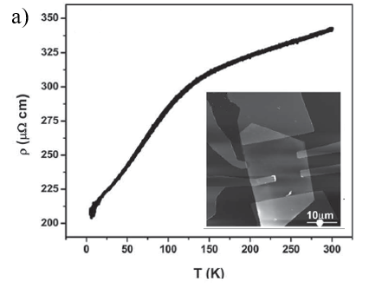
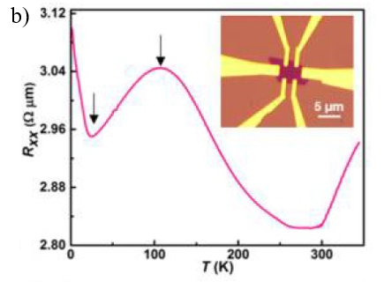
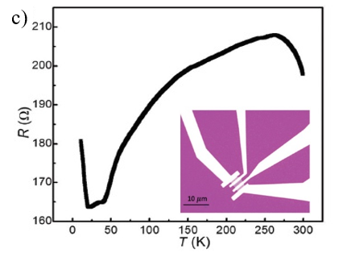
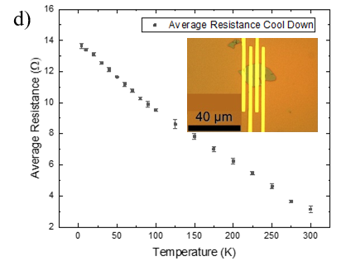



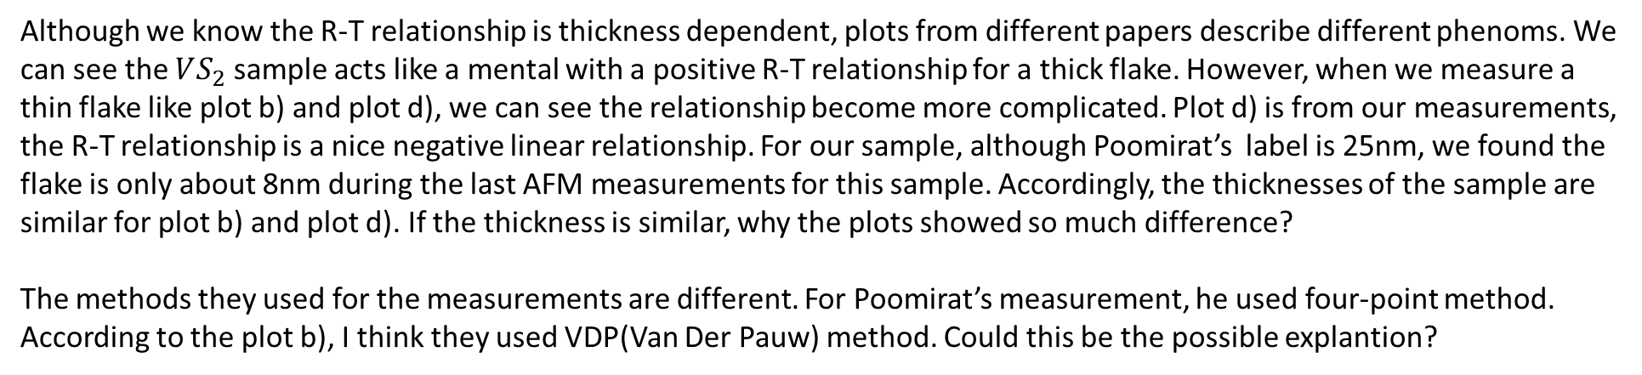

Weekly report 02/03/2020-02/09/2020 Tengteng Tao
Question:
42.5nm $VS_{2} ρ−T$ curve
6.7nm $VS_{2} ρ−T$ curve
30nm $VS_{2} ρ−T$ curve
25(8)nm $VS_{2} ρ−T$ curve
Although we know the R-T relationship is thickness dependent, plots from different papers describe different phenoms. We can see the $VS_{2}$sample acts like a mental with a positive R-T relationship for a thick flake. However, when we measure a thin flake like plot b) and plot d), we can see the relationship become more complicated. Plot d) is from our measurements, the R-T relationship is a nice negative linear relationship. For our sample, although Poomirat’s label is 25nm, we found the flake is only about 8nm during the last AFM measurements for this sample. Accordingly, the thicknesses of the sample are similar for plot b) and plot d). If the thickness is similar, why the plots showed so much difference?
The methods they used for the measurements are different. For Poomirat’s measurement, he used four-point method. According to the plot b), I think they used VDP(Van Der Pauw) method. Could this be the possible explantion?

